Slide 1
Conference 10th May 2019 in Vienna “Administrative Judges in Europe” recruitment – training – career Introduction into the Dutch System

Slide 2
Introduction
Annemiek Huigen
Responsible for the Initial Training Programme for Judges
and Leadership Training in the Judiciary and the Public Prosecution Service
& Judge in the disctrict court of Amsterdam
Notes:
As many of you I am a judge, but good to know: not an administratieve judge and never was.
I started my carreer as a prosecutor in Amsterdam and since 2001 I have been a judge. I worked as a criminal, a juvenale and a family judge and was also educated in the civil field of law. But no administrative!
Apart from that I have my job as a prosecutor and later as a judge often combined with other tasks, interesting to mention might be my experience as a trainer, responsible for recruitment and training of judges in Amsterdam and in 2012 as a projectleader for a new initial programme for judges. After that I was detached at the ministry of justice and worked 3 years full time as a programmanager for the digitalisation of the criminal proces (police, prosecution and judiciary)
These days I am partly detached at the national traininginstitute

Slide 3
Agenda
Introductory remarks
Context and organigram of the Dutch system
Funding of the Dutch system
The new recruitment procedure
The realisation of a new Initial training programme for judges
The initial training programme for judges
The intake procedure
Lessons learned
Weaknesses and strengths
Summary (3 most important ingredients for succes)

Slide 4
Introductory remarks
New judges are being recruted and trained as generalist and not as specialist
Therefore in the Dutch system there is no difference made for recruitment, training and career of new administrative judges and other judges
The potential field of conflict, that administrative judges who control decisions of governmental bodies are depending on governmental endowments for their training, has not posed any issues in the Netherlands so far.
Notes:
Ad 1 This is policy in the judiciary. A judge is in principe deployable in two different fields of law (all kind of combinations are possible between civil law, administrative law, criminal law, family law…)
The aim is:
to keep our organisation flexible. Sometimes the amount of criminal cases increases and in the same time there are less civil cases.
Vital, to keep experienced judges active and motivated
Broad view
Ad 2 That also means that I will speak about our recruitment procedure and initial trainingprogramme in general. I won’t focus on career so much, because that is also not different for administrative judges. If there are questions about the career of judges in the Netherlands, I will try to answer them later..
Ad 3. We are a pragmatic society. This potential field of conflict didn’t motivate us to make difference. In practice it doesn’t cause problems. Administrative judges can operate totally independant. To give you an idea: 75 % of the administrative cases against a governmental body prove to be unfounded. In the other 25% the government will correct their decision without protest, other than going in appeal.

Slide 5
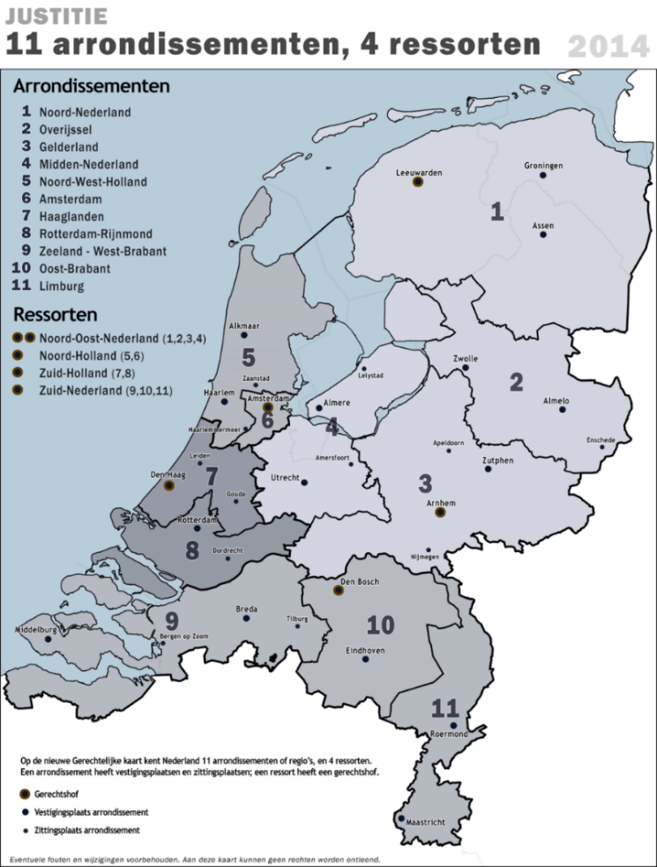
Context of the Dutch system
The Netherlands
17 million inhabitants in the Netherlands
11 district courts
4 courts of appeal
3 specialised courts of appeal for administrative cases
1 supreme court
Notes:
National court structure
The Judiciary has in 2013 evolved from 19 district courts, 5 courts of appeal en 1 supreme court into:

Slide 6
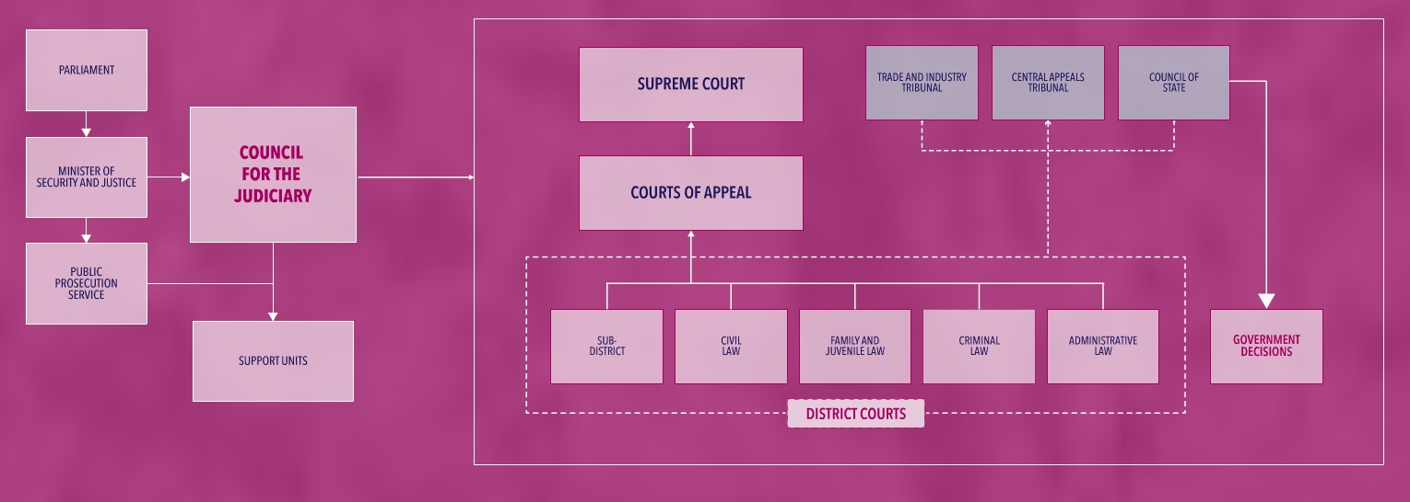
The Courts and Council of State
Notes:
The administrative division in first instance is integrated in the district courts.
In appeal we have apart from the courts of appeal, 3 appeal bodies specialised in adminstrative cases. In the law is registered which kind of cases go to which body.
We have about 2500 judges working in the judiciary
1.6 million cases in 2018 in total
Administrative cases in first instance: 100.000 (40.000 administrative, 35.000 foreigners and 25.000 tax)
in appeal: 13.500 (3500 tax en 10.000 CRvB en CBB)
In these figures the cases of the Council of State are not included

Slide 7
The independant Council of State
A budget directly from the House of Representatives
Two separate divisions:
An advisary division for the government
A judging division for specific administrative cases in appeal (f.e. cases about foreigners) and in first instance cases about environmental planning
The council judges are appointed directly by the Council of State
These judges are professors of university, ex-lawyers and ex-judges from within the Judiciary
Internal on-the-job training for these judges

Slide 8
The Council for the Judiciary (2002)
Notes:
Statutory duties and responsibilities:
Reason to install the Council: to get a more effectively and independent system. The council does not judge!!!
Among other things the Council is responsible for
Financial economic policy
Allocation of the budget to the different courts.
Budget for the judiciary nearly 1 billion euros
Management
Quality
Integrity
Advice on legislation
IT, selection and training, academic research
Communication and international cooperation

Slide 9
Funding of the Dutch system
Notes:
So far some background information

Slide 10
In 2014 we implemented a new recruitment procedure and a new initial training programme for judges
Reasons to reconsider the old situation:
The rapid changing demands of society
Not enough diversity among judges
Combination coaching/training and assessment in one hand
Rigid Initial training programme:
1 year for highly qualified professionals with high failure risk (not appealing)
4-6 years for young high potentials combined for prosecutors and judges

Slide 11
Preparatory steps
In 2010 the Council of the Judiciary decided that it was time to evaluate the recruitment procedure and the initial training programme
In 2012 a projectgroup modernised the profiles of judges, including the ones for a beginning judge in a district court and in an appeal court
The requirements for entering the initial training (legally registered) were adjusted:
- Master in law
- At least 2 years of working experience in a legal profession (newly added)
In the same year (2012) the Council produced two assignments for projects with the new profiles for beginning judges as a starting point :
A new recruitment procedure
A new initial training programme for judges
Notes:
Evaluations: there were several evaluations in several relevant bodies mainly within the Judiciary.
The new profiles of judges were renewed so they correspond more with the demands society has of the judiciary.
In short this meant that a good judge is no longer someone who is able to analyse a legal problem, ask parties questions about the relevant facts and afterwards can write an intellectual judgment.
The new profile demands more awareness of what is at play in society: it demands that a judge also can really communicate in court, makes connection with the parties and tries to solve the real problem behind the legal problem.
Requirements: In general you need to work 6 years in a legal profession before you can become a judge. This demand hasn’t changed. We only added the two year demand before you can go in training…
In practice: the 2 years need to be relevant legal work, and in practice it is necessary that you can prove somehow that you are social oriented. F.e. by doing voluntary work in a social field.

Slide 12
The new recruitment procedure
Notes:
The projectteam with the assignment to produce a new recruitment procedure was advised about the last scientific insights about effective recruitment by the Erasmus university. One important insight f.e. was that it was very important to differentiate between competences in the profile who one can develop and which one can not develop. The advise was to use selections tools and standards that have a good predictive value and are free from cultural values as possible.
That is the reason that we introduced an analytical test in the beginning of the procedure. This is a good predictive instrument. If one doesn’t make the test sufficient, the candidate can’t go through with the procedure.
(the analytical test: verbal capacity tot reason, abstract thinking, sense of language)
Another insight we used is that a good assessment is a far better predictive instrument than the interviews. So the interviewers in the new procedure always get the result of the assessment at forehand instead afterwards!.
(The assessment: takes 5 hours: a interview, questionary about their personality and tests (intelligence, integrity, social behaviour, their ability express themselves and to decide. Includes a so called “Dark test” to test addiction or psychiatric disorder)
Another important improvement was that the national committee LSR now consists of: a Presidium: a president of a appeal court, a president of a district court.
Members: 6 judges and 6 other members, 1 prosecutor, 1 lawyer and 4 external (f.e. a journalist). An substantial reduction of the number of members to gaine more experience.
The interview of the national committee focus on: cooperation, delegation, social orientation etc.
If everything is positive: the condidate gets a so called “green light”.
The latest step is a local interview: In that interview one test if the candidate is also suitable for that court.
If not: he or she can apply for a vacancy in maximum two other courts.

Slide 13
The new initial training programme assignment
Starting points:
the new profiles for beginning judges
Preserving:
the networking environment
training on the job
training in two-three working environments (legal sections)
New: Tailor made to individual training needs
Notes:
As I already mentioned: the profiles were the starting point
The evaluations of the existing programmes made clear that the strong points were:
trainees from different courts working together at the traininginstitute as a group, and create a strong network
The training on the job in their own court
The organisation goal: judges who are able to work in more different sections,
The big new challenge was: the objective : tailor made!!

Slide 14
Overall leading criteria
High quality
Flexible
Didactic innovative
Appealing for legal professionals
Notes:
Apart from an extensive list of objectives in the assignment, the assingment also mentioned 4 overall leadig criteria.
These criteria stood central during the whole designing proces!! They were a clear set of reference points throughout the whole designing process

Slide 15
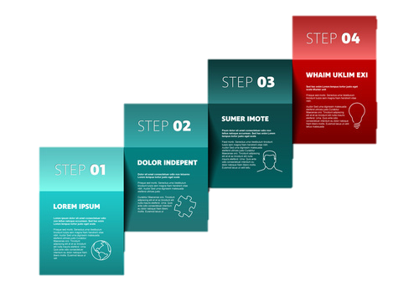
Proces for designing the initial programme
Step 1: Clustering competencies of a beginning judge in 5 themes
Step 2: An educational philosophy
Step 3. Investigate the feasibility of modular training
Step 4. Drawing the design
Drawing
the design
Modular
training?
Educational
philosophy
Clustering
competencies

Slide 16
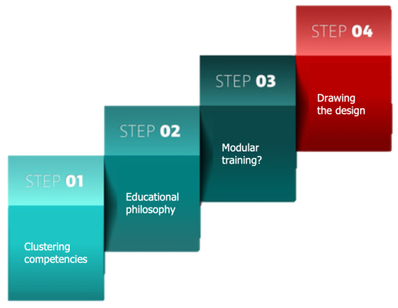
Step 1: Clustering competencies of a beginning judge in 5 themes
Preparing court session
Cooperation
Communi-cation
Intervision
Court session
Magistracy professio-nalisation policy
Verdicts and decisions
Notes:
We clustered the many competencies of the profile of the beginning judge and appeal judge in 5 themes.
The first three are very recognizable, I suppose
Magistracy/ professionalisation:
Old: integrity, independent, impartial and professionalism, .
New:
Awareness of social consequences of a case, what is at play in society
More attention to: what it is to be a magistrate, 24/7, what is your position as a judge in the TRIAS
Professionalisation: how to deal with ethical dilemma’s,
Policy: are you aware of policy agreements, that you are part of an organisation, although you decide independent?
New:
More rapid judgment adressing the real problem that’s why there is more focus on cooperation: more need to cooperate internal and external
Communication: more focus on different styles, transparency
Intervision: learning with eachother, feedback etc.

Slide 17
Step 2: An Educational philosophy
High quality
Flexible
Didactive innovative
Attractive
A trainee judge as a colleague
Ensure a stimulating learning environment by using existing knowledge and talent as the basis for the programme. The relationship between trainer and trainee will be freed from the pressure of assessments insofar as is possible, by arranging for a more objective and varied test of competence.
Make the programme reflect the profession of judge/member of the bench as an independent profession insofar as pos- sible. Trainees will be given more responsibility and control over what they learn and how they learn it, with a view to the exit qualifications. The trainer will function as coach, with the court as a whole as the educational institute.
Allow the trainees to work together in educational/research teams in which they can acquire knowledge and share experi- ences where necessary. The teams can also present proposals for improvement to the organisation.
A programme in which these principles are consistently applied (in the structure and implementation) will achieve better educati- onal returns and help to reduce the dropout rate. This innovative didactic foundation will also contribute to the quality, flexibility and appeal of the programme.
The Training and Study Centre for the Judiciary (SSR) is working on a new initial judicial training programme in the Netherlands on behalf of The Council for the Judi- ciary. The first trainee judges are expected to start the revamped programme in the autumn of 2013.
SSR: Excellent training for a just society
Notes:
Ad 1: ensure a stimulating learning environment by using existing knowledge and talent as the basis. Relationship between trainer and trainee will be freed from the pressure of assessments
Ad 2 Make the programme reflect the profession. That means trainees will be given more responsibilty and control over what and how they learn
Ad 3 Allow trainees to work together in teams to acquire knowledge and share experiences and even as a team can present proposals to improve the organisation

Slide 18
Step 3: Investigate the feasibility of modular training
Flexibility possible
Continuous educational curriculum
A general module makes it possible to work as a group and pay attention to the new competencies (2 themes)
Notes:
Ad flexibility: more modules makes it possible to train in different levels
An important condition in this respect is, to have a clear continuous curriculum
A general module during the whole training period makes it possible for trainees to work toegether as a group

Slide 19
Step 4. Drawing the design
Fitting in the Judiciary daily practice
Focussing on the 5 themes of the profile
Reflecting the educational philosophie
Modular
Meeting the assignment criteria and objectives

Slide 20
Initial training program for judges (2014)

Slide 21
Self-evaluation
Assessment interview
Every three months
Assessment &
certificate
Assessment interview
Every three months
Assessment interview
Every three months
Assessment &
certificate
Preliminary phase
3 months
Min.
6 months
Max.
2 years
Min.
6 months
Max.
2 years
Main phase
Min. 1 year
Max. 3 years
9 months
Notes:
This is the infographic of our current initial programme;
In highlight:
The preliminary phase: an innovative component, that covers the first three months of het programme
After these period the trainee understands:
the whole breadht of the profession and the judicial system
Which skills and competencies they still need to develop
And started a workteam with other trainees, a basis to share knowledge and intervision throughout their later careers
The blue part: the trainees spent time in their own court and in the law division (work-environment) in which they start the mainphase after this pre phase. Free from productivity pressure and free from assessment (they can really practice and make mistakes)
In total: this phase is an example of the culture shift that is a key aspect of the new programme and the judicial as a whole
2. This phase ends with a self evaluation of the trainee (answering the question: Is being a judge really the right thing for me? and a Personal Learning Plan. Also the start of their digital portfolio!
The trainees are guided by core trainers, who will guide them throughout the whole training programme, mainly in the orange part. That means not during the training on the job (blue part). The core trainers (new function) are judges who are an ambassador of the new educational philosophy and their task is to coach the trainees as wel as the trainers in court in their new role!
New for the trainers in the court is that they are no longer involved in the decision whether a trainee is suitable to become a judge. Their job is to coach the trainee and their feedback and evaluations are concerning the learningprocess of a trainee.
In the blue part, when the trainees are in their own court they are always guided by two trainers who guide them during their training on the job. Every new work-environment the trainers will be different.
Start of the mainphase:
Work environment 1: this is the first law division in which they will be trained on the job. That can be the administrative division but also another one.
Minimal 6 months, maximal 2 years
New are the internships: minimal 1 week maximal 6 months
one to the appeal body in the same area of law or when the training is in an appeal body an internship in the district court
A social oriented internship or
when you are trained in the criminal division: an internship at the Public Prosecution Service as a prosecutor
Every week on Friday a learn-work team of trainees, formed in the preliminary phase, meet eachother to focus on the new competences magistracy, cooperation etc.
Also an short international internship is included in this part.
The trainees can influence the learning activities in this orange part of the programme (being responsible and take control of their own learning programme)
Nice example: trainees get -after 15 months- so called credits. That means every trainee is free to spend these credits in a way they think is worthwile for him of her.
The goal is also that they can work together at a assignment to improve the organisation and where they can use the knowledge they took with them from their formal job/experience and are able to use their own talent
During the orange part the traininginstitute delivers several courses, but there are also courses in the blue part related to the different work-environments.
After the preliminary phase:
Every three months their will be an assessment interview with the trainee, core trainer and trainers. Question: looking at the personal learning plan and the portfolio: how is everything going?
3. And after 6 months there will be an assessment by a – special trained - national assessment committee.
This committee decides whether a trainee can go on with the training programme or no,
The portfolio of a trainee is the base of that assessment . In the portfolio: written concept judgments, reports from the assessments interviews etc…Core trainer and trainers approve the input of the portfolio by the trainee. The input is partly compulsary and partly optional)
Important: the core trainers and the trainers are not involved in this assessmentcommittee!
4. The duration of the training programme is minimal 15 months and maximal 4 years, always including the 3 months of the preliminary phase.
If a programme is minimal 2 years and 3 months the trainee can be educated in 3 different work-environments! It is optional
5. Finally: everything a trainee does and learn in the programme has to be in one way or another connected to one or more of the 5 themes and must be based on the Personal Learning Plan of the individual trainee.
That’s the challenge!!!
It always ends with the final assessment of the national committee

Slide 22
Intake Procedure
Notes:
After a candidate is selected and before he or she starts with the programme their is one more step to take:
An interview by an Intake committee (judges experienced trainers) and a secretary from the traininginstitute):
That committee advises the president of the court :
How long the trainingprogramme needs to be (15 months or longer)
In which law fields (work environments) the trainee will be trained and in how many!!

Slide 23
Lessons learned
Professional projectmanagement
Diversity in the projectteam
Input of external expertise and international inspiration (EJTN)
Neccesity of cooperation with stakeholders throughout the whole Judiciary
A mandator who monitors the implementation of the original design
External visitation after implementation
Notes:
Ad 4.
If you design a new programme which means that a culture change in your organisation is needed, to succeed in the implementation you need ambassadors throughout the whole Judiciary of that new design!!!

Slide 24
Weaknesses and strengths of the training programme
Weaknesses
Complex planning system
No participation of trainees directly from the University (losing unique talents)
Strengths
A low failure rate
Tailor made
Uniform and independent assesment
Diversity (sharing knowledge and legal experience)
Flexibility
Internships
Notes:
I was doubting to put the complexity of our assessment system as a weakness, but I didn’t. It is complex system but the gain of transparency and objectiveness is worth it.

Slide 25
3 most importants ingredients for succes
Clear vision of the organisation (f.e. the judge as generalist or a specialist?)
Profiles for judges who respond the expectations of society
An inspiring educational philosophy

Slide 26
Questions?

Slide 27
In case of questions I can show one of the below sheets!

Slide 28
Summary initial training programme
Self directed learning
Modular structure
Training on the job (70%)
Tailor made curriculum (learning activities, internships)
Length: min. one year and max. four years, one-three working environments

Slide 29
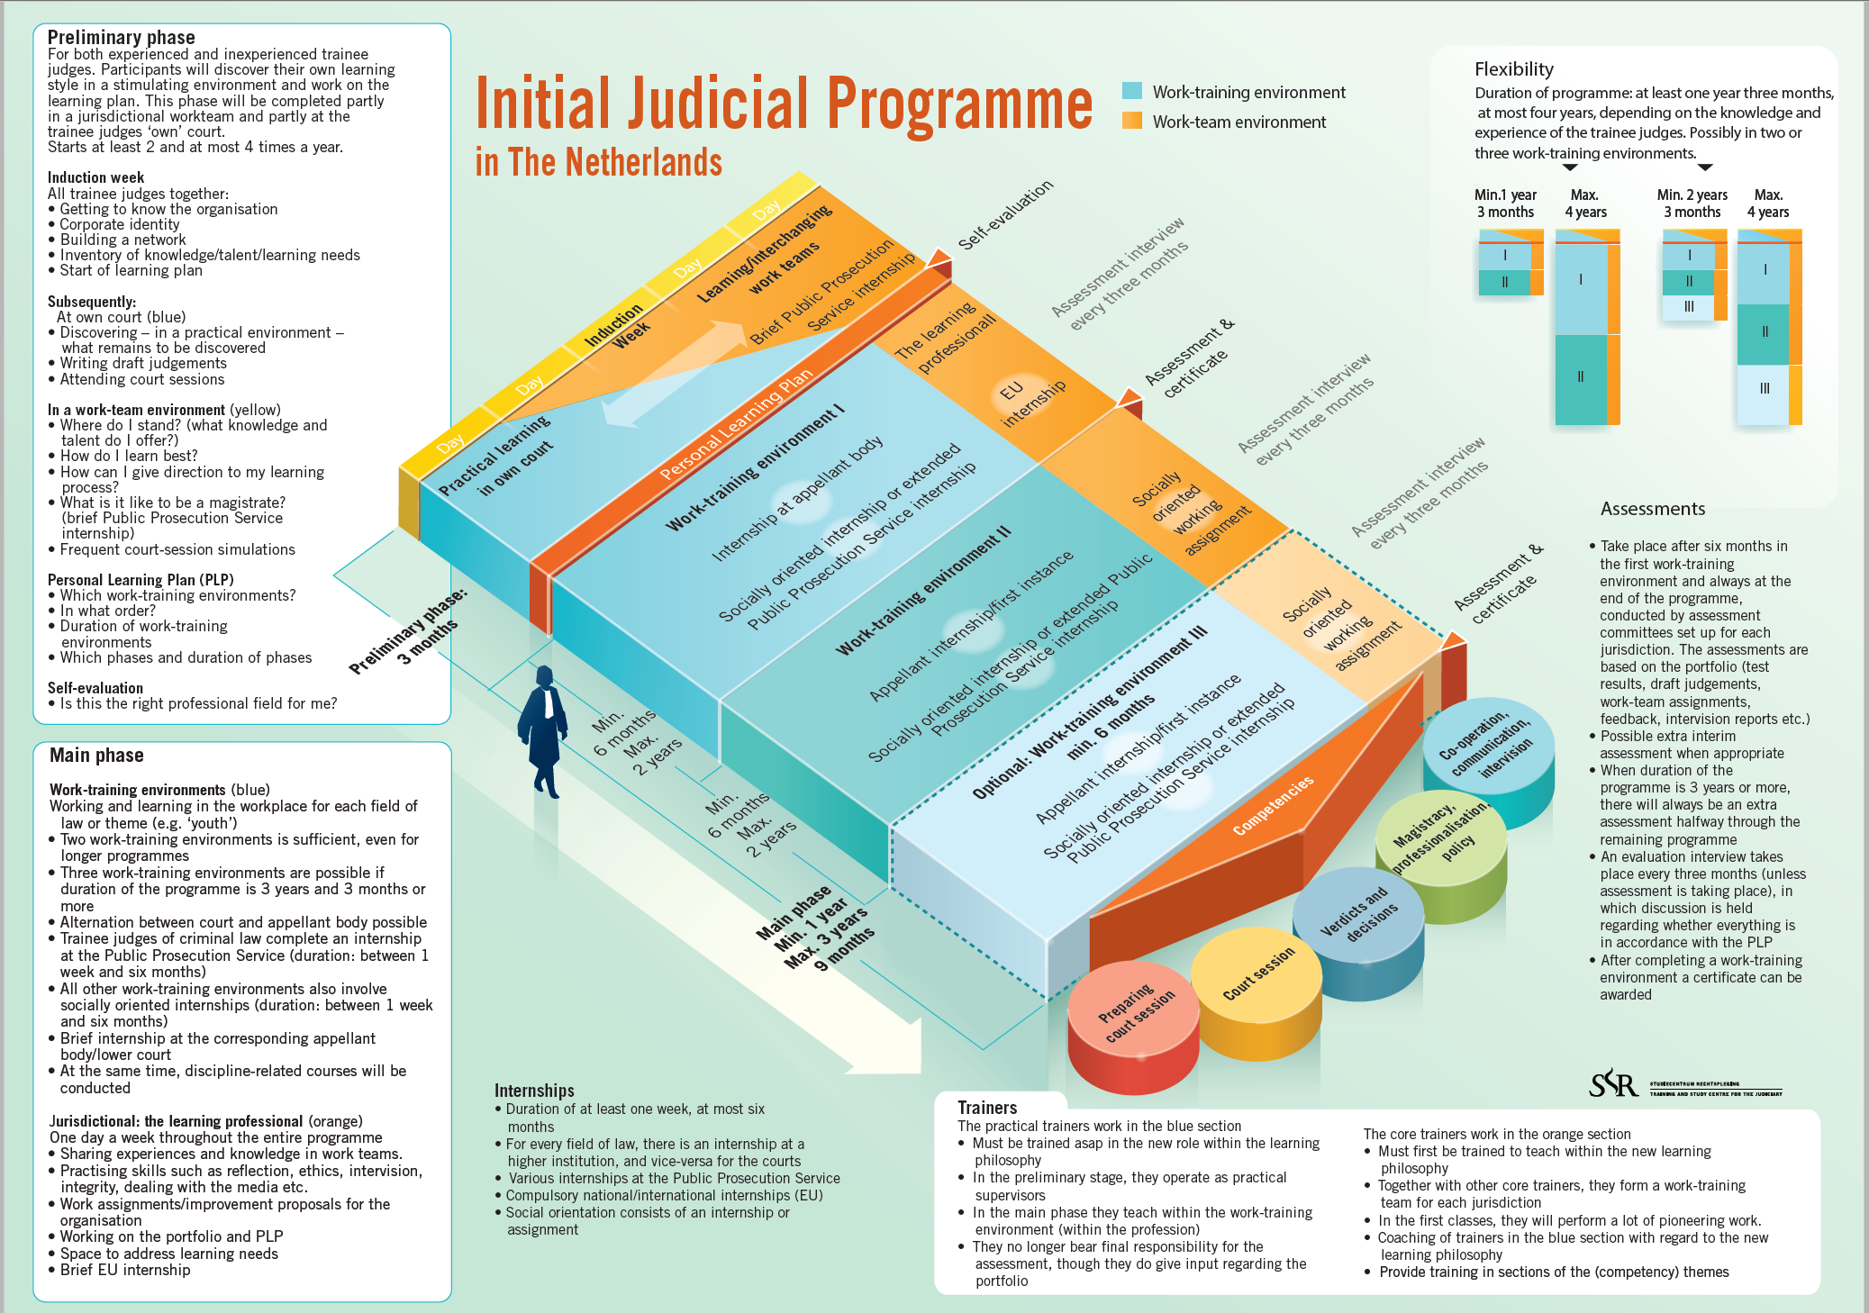

Slide 30
Assesment
National assessment committee (uniformity)
Digital portfolio (responsibility trainee judge)
Transparency
Quality (i.a. validity and reliability)
Optimizing quality/preventing biases
Group processes/Group think
Judgement and decision-making
Evidence based (feedback)

Slide 31
D Theme: Magistracy/Professionalisation/Policy

Slide 32
Learning activities with specific focus on magistracy/integrity
Introduction week
Where do I stand as a judge?
The independent judge from an international perspective
Structure of organisation and financing of the Judiciary
View from society on the Judiciary
Professional ethics

Slide 33
Integrity in other learning activities
Intervision
Training in chambering
Training in court sessions
Training in cooperation and feedback
And during evaluation with practical trainer and core trainer

Slide 34
Training on professional ethics
Trainers: academic researcher and judge
Location: outside working environment and isolated from other groups
Participants: trainee judges and experienced judges, max. 12
Timing: last half year of the programme
Safe learning environment

Slide 35
Analysing an ethical dilemma
Concrete, actual situation
Legal question v. ethical question
Interests: Institutional values and interests, values and interests of all parties
Rules: Codes of conduct, traditions and/or unwritten rules
Description of most radical positions
Individual views of participants

