Slide 1
The Selection and Training Procedures for Administrative Judges in England and Wales
Hugh Howard
Regional Tribunal Judge
Social Entitlement Chamber

Slide 2
Tribunal Structure (Administrative Courts)
United Kingdom has different regional jurisdictions:
England and Wales (Wales is gradually becoming a separate jurisdiction)
Scotland
Northern Ireland
Isle of Man; Channel Islands
Each jurisdiction has different arrangements. This presentation deals with England and Wales.
Some Tribunals do sit across different regional jurisdictions.

Slide 4
Typical Chamber Structure
Social Entitlement Chamber – Social Security and Child Support Tribunal
Chamber President (salaried)
Seven regions each headed by a Regional Tribunal Judge (salaried)
Each region will have 15 – 20 District Tribunal Judges (salaried)
Each region will have:
One Medical Member (salaried)
90 Tribunal Judges (part time)
90 Medical Members (part time)
45 Disability Members (part time)
4 Financial Members (part time)
4 Tribunal Case Workers/Registrars (salaried)
Judges have no responsibility for any administrative staff

Slide 5
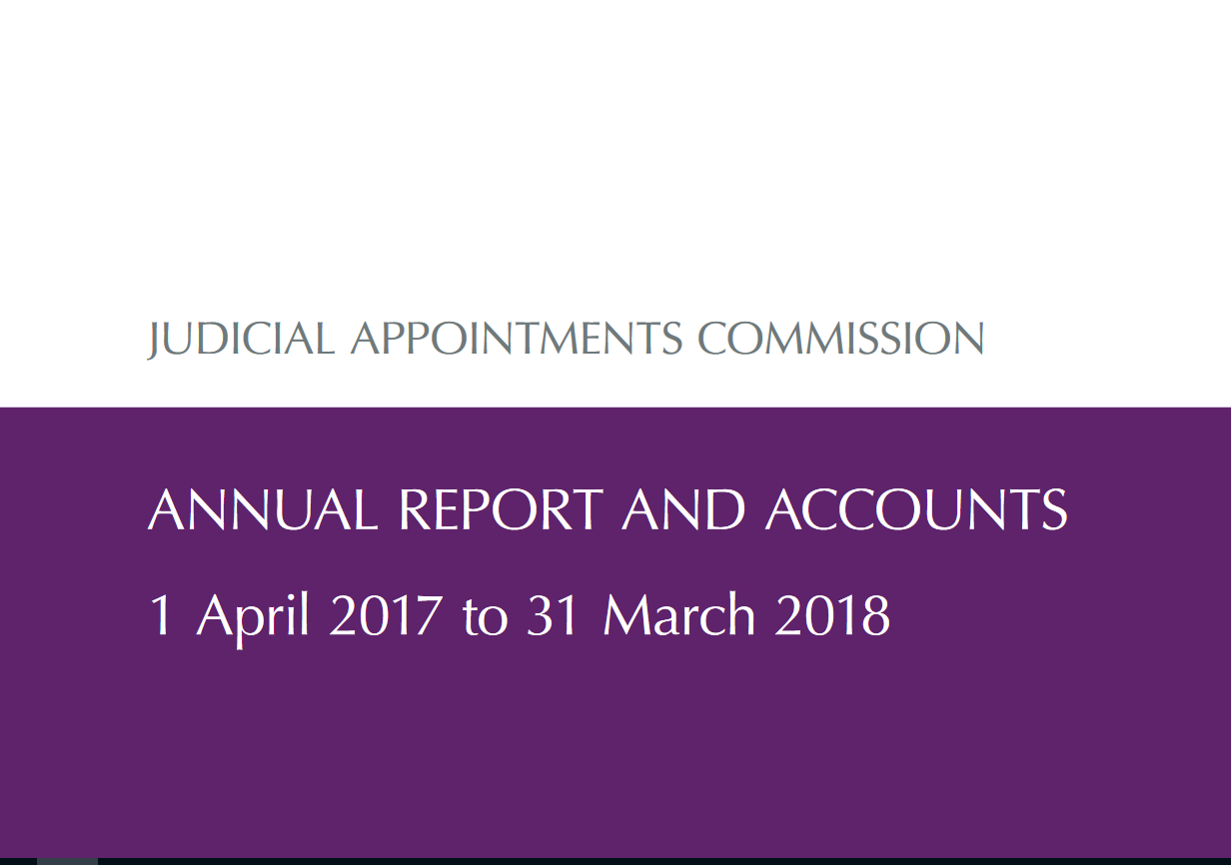

Slide 6
Composition of Judicial Appointments Commission
Fifteen Commissioners appointed by HM Queen
Lay (non lawyer) chairman
5 lay members
6 judicial members
2 professional members (e.g. practising lawyers)
1 non-legal judicial member (e.g. magistrates)
The Commissioners oversee the work of the JAC
The JAC employs staff to support the Commission
Interviews are conducted by (usually) two lay panel members and one judicial panel member
Some interview panels may include a specialist member, e.g. Medical doctor, Surveyor, etc.
Interviews address the 5 core competences and may include a role-play or presentation by the candidate

Slide 8
Judicial College
Largely a ‘virtual college’
No academic premises – it uses commercial conference centres and hotels
Small administrative staff
Educational Development Advisers and psychologist
Two Judicial leads, one for Courts, the other for Tribunals
All jurisdictions have their own Judicial training lead
Innumerable Course Directors, senior tutors, etc largely drawn from salaried judges, some fee paid judges and some ‘external’ speakers
Very sophisticated e-learning modules, presentations and other materials

Slide 9
Recruitment process (1)
Chamber identifies its needs
Makes a business case to H.M Courts and Tribunals Service
Approved by Ministry of Justice as budget holder
Judicial Appointments Commission then recruits based on request
Process for Courts and Tribunals very similar
The process is very competitive with, sometimes, 2500 applying for 100 positions
Some competitions are ‘generic’ – i.e. across a range of jurisdictions
Some ‘specific’ – aimed at one jurisdiction
Some require previous judicial experience/jurisdictional knowledge

Slide 10
Recruitment Process (2)
Each competition varies but typically a candidate to be a Tribunal Judge must be:
Solicitor, Barrister, Legal Executive having practised for 5 years or an ‘exceptional’ candidate
No minimum age but it would be almost impossible to satisfy the above before aged 30
Be of good character, which includes motoring and criminal convictions, professional malfeasance, financial irregularities
No intelligence test. Some competitions do have a psychologist as part of the interview process and many competitions are checked by a psychologist and diversity expert
Competitions are open to anyone and never by invitation. They are widely advertised
Candidates are assessed against 5 competences:
Exercising Judgment
Possessing and building knowledge
Assimilating and clarifying information
Working with others and communicating
Managing work efficiently, including use of IT

Slide 11
Recruitment Process (3) (Typical but many variations)
Candidate completes self-assessment application form based on 5 competences
At least two ‘assessors’ who know the candidate write confidential assessments based on 5 competences
Candidate sits at 45 minutes on-line ‘multi-choice’ exam, marked by computer
Candidate sits a 45 minute on-line ‘situational’ giving written answers to typical ‘what would you do?’ tribunal based situations, marked by judge and panel member
Candidate sits a 45 minute on-line ‘critical analysis’ of, say, a section of a judgement, marked by judge and panel member
The above reduces the number of candidates to, roughly, 2.5 candidates for each job
On assessment day candidates are observed in a difficult ‘role play’ lasting for 30 minutes using actors in a tribunal hearing
Then 45 minute interview based on 5 competences
At all stages each step ‘moderated’ and checked

Slide 12
Recruitment Process (4)
Final moderation of all candidates
Recommended candidates considered by Commissioners
Commissioners make recommendations
Statutory Consultation of judges who may know something about candidates
Deployment exercise as to where and in which jurisdiction
Final recommendation goes to Senior President Tribunals with
Senior President approves appointment
Letters of offers go out
Candidates have to accept offers in writing
Offers confirmed and handed to Chamber Presidents and Judicial College for final deployment and training

Slide 13
Training – after appointment
All training takes place after appointment – as soon as possible
Usually a 2 – 4 day jurisdictional specific course on the law
From April 2019 all new judges will attend a 2 day ‘Judge craft’ course dealing with the psychology of judging, stressful situations, communication skills, etc.
Judicial College, Judges and Educational advisers devise and deliver training
Judicial Associations are not involved in training
Thereafter regular training courses at least annually and sometimes more depending on changes in legislation

Slide 14
Right to challenge and appointment of Presidents
There is a complaints process and there are the usual rights to take court proceedings for, say, discrimination
With a view to promoting diversity if two candidates are exactly the same and there is only one job then the person who is from an under represented section of community will be preferred
All appointments, including Presidents, follow a similar pattern. The convention is that a more senior judge than the post being applied for will be the judicial member of the panel
At the moment all tenures of Tribunal Judges of whatever grade are until aged 70 with the possibility to extend to 75. That is being reconsidered at the moment
If a position disappears then the Judge will be re-assigned to another jurisdiction but on a protected salary

Slide 15
Strengths and Weaknesses
Strengths
The JAC is properly independent
Although Judges on the panel are very influential, they are in the minority
Diversity is improving but not yet good enough
The process is thorough and demanding
Weaknesses
Takes far too long
It can take 6 months for HMCTS to make a request to JAC
JAC process from initial advert to Judge in post is about one year
Judiciary is still not sufficiently diverse
No ‘aftercare’ for disappointed candidates and very limited feedback as to why they were unsuccessful

